Slide 1
Model-based Integrated Planning and Control of Autonomous Vehicles using Artificial Potential Fields with uncertain environment
Emilio Benenati
Josyula Viswanath Das
28th July 2021

Slide 2
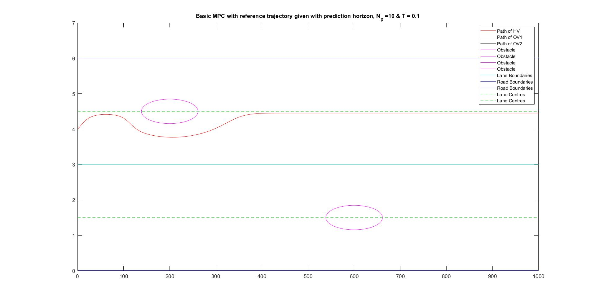
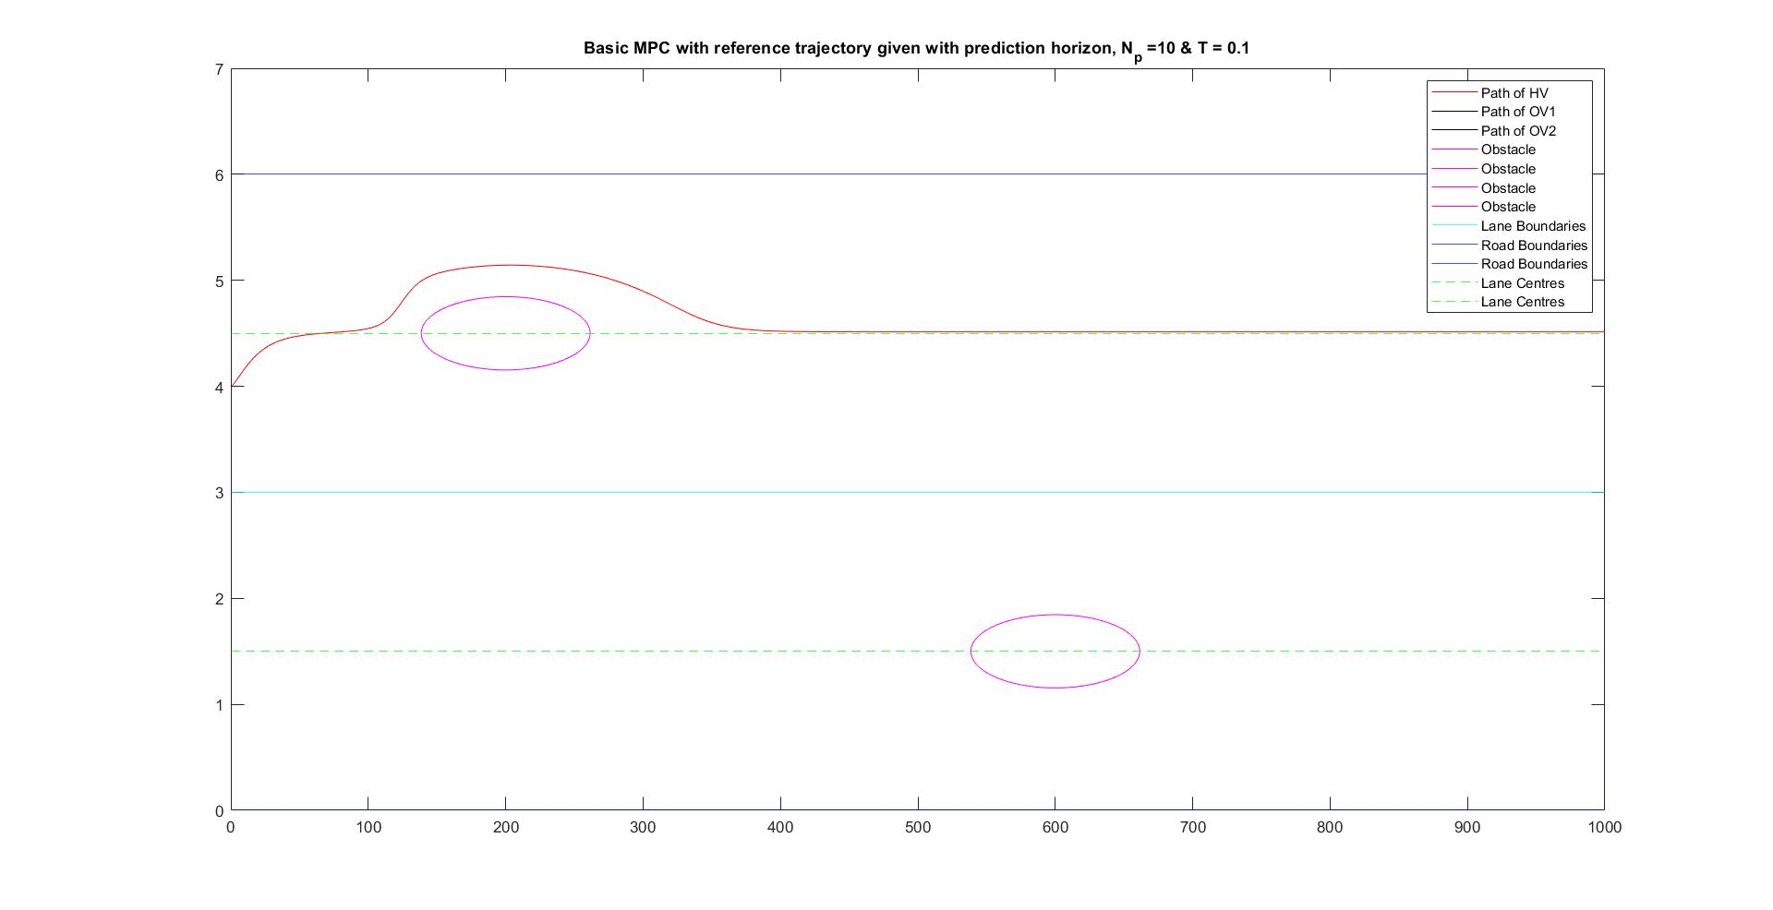
APF+ MPC with stationary OV with no cost on change in state

Slide 3
APF+ MPC with stationary OV with cost on change in state

Slide 4
APF+ MPC with stationary OV with cost on change in state and noise

Slide 5
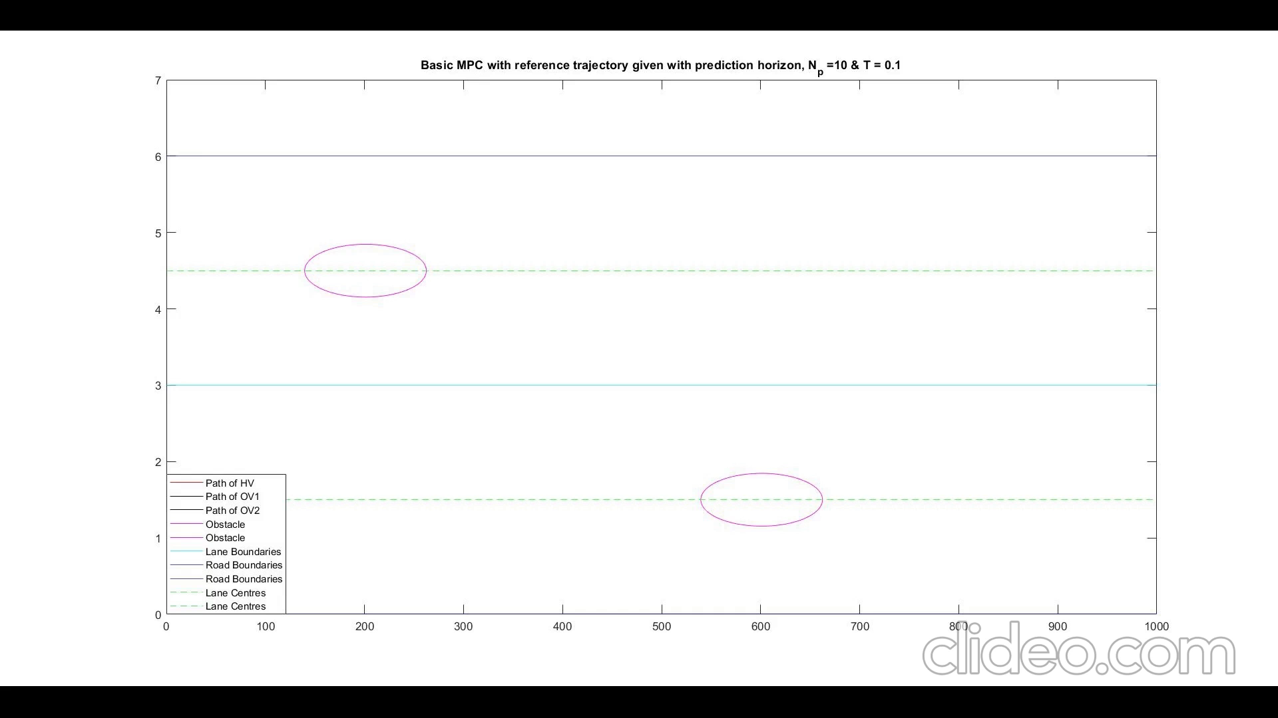
APF+ MPC with Moving OV with HV velocity>OV velocity

Slide 6
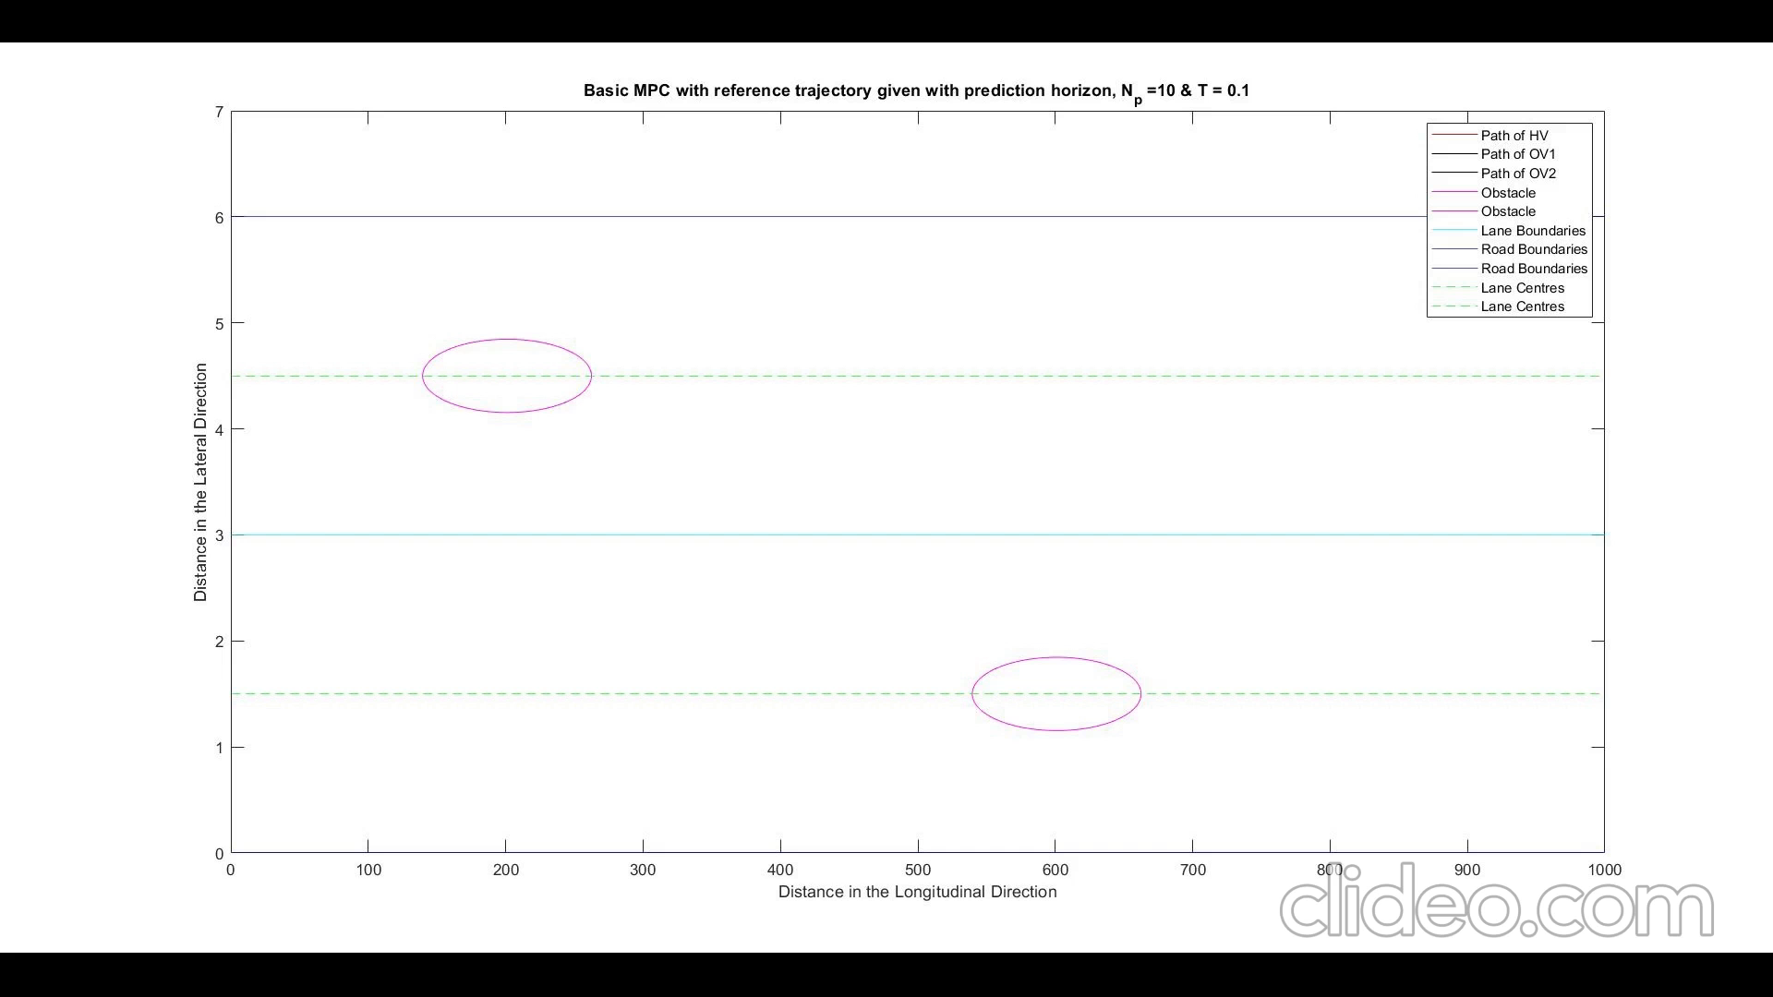
APF+ MPC with Moving OV with HV velocity< OV velocity

Slide 7
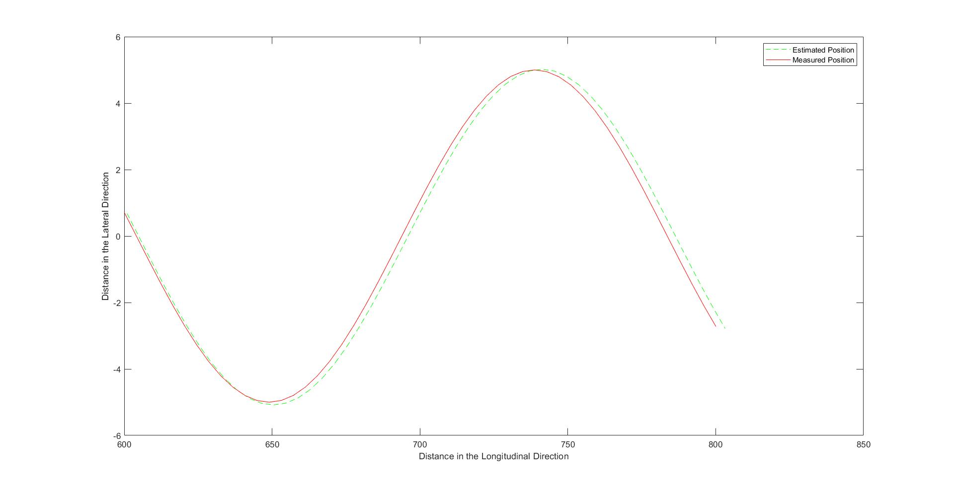
Kalman Filter

